Slide 1
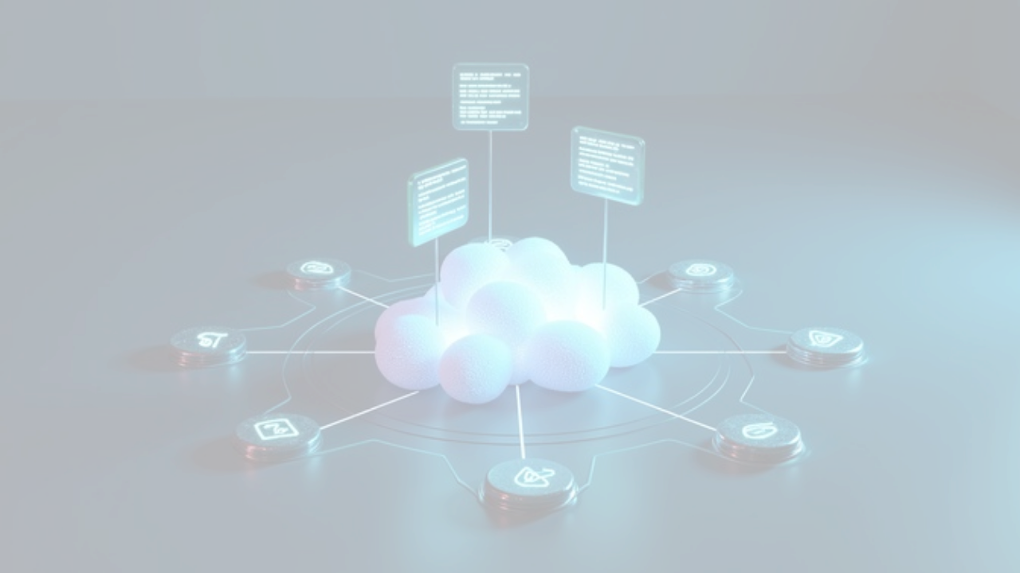
TECHNICAL ASSESSMENT
Scalable 3-Tier Serverless Architecture
Automated continuous delivery on Google Cloud Platform.

Slide 2

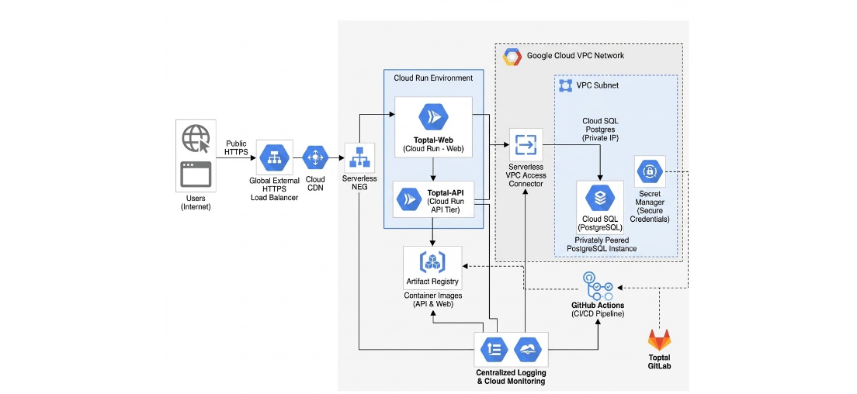
System Architecture Overview

Slide 3



Core Design Principles
Zero Overhead
Strict Isolation
Immutable State
Fully serverless compute nodes.
Private data tier networks.
Git-driven infrastructure provisioning.

Slide 4

TIER 1
Global Delivery & Edge Routing
Cloud CDN: Cached static assets.
50ms
Serverless NEG: Native Load Balancer attachment.
Target global response latency
Cloud Run (Web): Auto-scaling frontend hosts.

Slide 5



Backend Integration & Data Isolation
API Tier
Database Tier
Security
Stateless logic execution.
Cloud SQL PostgreSQL.
Secret Manager integration.
VPC Connector: Bridges serverless compute to private networks.
Private IP Only: Zero public internet exposure.
Dynamic Injection: No hardcoded credentials in Terraform state.

Slide 6
Automated Delivery Pipeline
GitHub Actions workflow execution steps
1
2
3
Build & Push
Deploy Revisions
GitLab Mirror
Compile containers to Artifact Registry.
Zero-downtime Cloud Run native traffic splitting.
Force-push state to Toptal environment.

Slide 7

Architecture Review
Questions & Technical Deep Dive

Slide 8

Image Sources
https://images.stockcake.com/public/4/a/5/4a555310-699e-405e-89fe-6214074f5e1d_large/cloud-network-infrastructure-stockcake.jpg
Source: stockcake.com

